Slide 1
17-612 Fall 2023
Business & Marketing Strategy
Class 1
Jim Berardone
Associate Professor of the Practice of Product Management

Slide 2











Your Instructor
Jim Berardone
Associate Professor of the Practice
of Product Management

Slide 3







Teaching Assistants
Breuna Bishop
CIT, MS E&TIM, Dec 2023
Ankita Bodigam
CIT, MS E&TIM, Dec 2023
Hemant Hari Kumar
SCS, MSE Scalable Systems, Dec 2023
Li Liu
SCS, MSE Dec 2023
Tepper, MBA May 2024
Anshul Modh
SCS, MSE Dec 2023
Akshita Patil
Heinz College, MISM Dec 2023
Yitian (Tony) Wang
SCS, MSE Dec 2023

Slide 4
94 Students in 3 sections
Section A1
54 students
SCS – S3D (51)
CIT (2)
Non-degree (1)
Classroom 265
300 SCR
12:30 to 1:50 p.m.
Section B1
28 students
SCS – S3D (20)
Heinz – MISM (4)
CIT (3)
CFA - MUS (1)
Classroom 265
300 SCR
5:00 to 6:20 p.m.
Section 41 (distance degrees)
12 students
SCS – S3D (10)
Heinz – ITM (1)
Non-degree (1)
Zoom
5:00 to 6:20 p.m.
Optional Recitation Session on Mondays – 7:00 to 8:00 PM by Zoom

Slide 5
How could understanding business concepts help you in your career?

Slide 6
Skills with business concepts can help you to:
Persuade others of your ideas
Use business decisions when planning and developing products, software, systems
Influence decision-makers to make better decisions about products, technologies, design, engineering and data
Collaborate with decision-makers in making those decisions

Slide 7


Slide 8
Why should we create this product?!
Make sure there is a strong answer to this question:
It is the responsibility of both of you to make sure there are strong answers.
You will need to recognize it is or isn’t strong.
You will need to use it, influence it, collaborate on making it strong.

Slide 9
Actually, there are 2 big WHY questions to answer:
Why would users want to use this product?
Why would it matter for our organization?

Slide 10
Why should we make this product?
1. Why would users want to use this product?
The product solves an important problem that the users have.
The benefits gained from using it greatly exceed the cost of buying and using it.
Benefits – Costs > 0.
2. Why does it matter to our organization?
It will help our organization to better serve its stakeholders, to grow and compete.
The benefits gained from creating and offering it greatly exceed the cost of creating and offering it.
Benefits – Costs > 0.

Slide 11
My Courses
This course
17-692
Product Management Essentials
17-612
Business and Marketing Strategy
Why would users want to use this product?
Why does it matter to our organization?

Slide 12
Ultimately, you want to…
Build the right product before you build the product right!
or, build the right product feature before you build the feature right.

Slide 13
About Products

Slide 14
I will use the term “product” for all of these types of products
Tangible products
Smartphone, Laptop, Car, Drone, Desk, Shoes, Soda
Intangible products
Software App, Insurance, Online Subscription, Data, Online Banking
Recurring Services
Wireless Service, Broadband Service, Electric Service
Programs
Warranty Program, Maintenance Program, Membership Program, Educational Program
“Product” is an offering that is created for many customers / users.
“Project” leads to something that is produced one time… a “one-off”

Slide 15
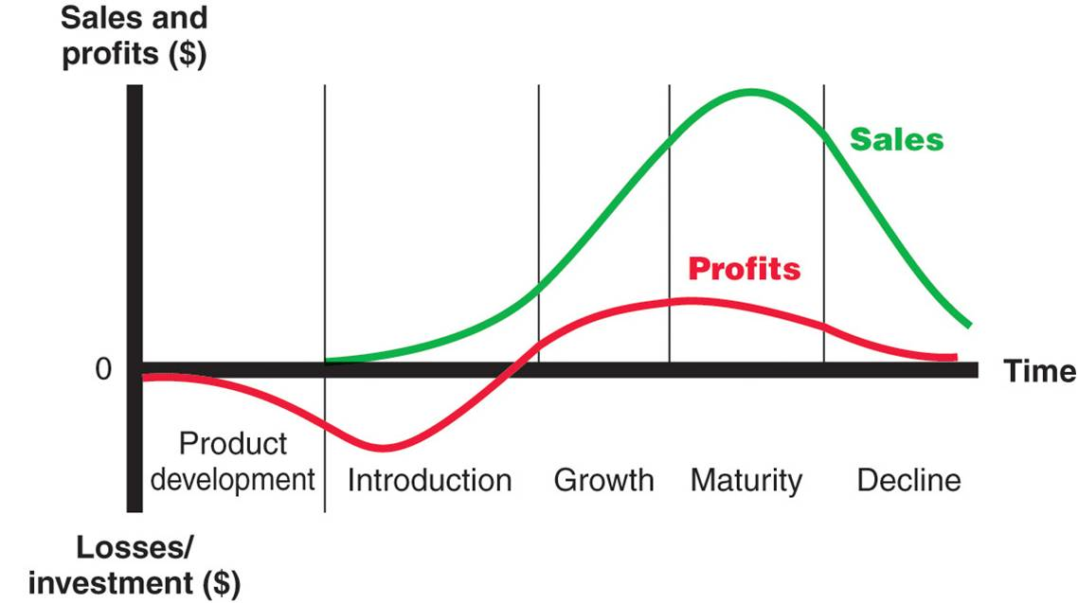

Products go through a life → The Product Life Cycle (PLC)
Illustration Source (left: http://integrabrasil.com/modal/product-life-cycle-stages-examples-798.jpg (right) VectorStock.com/36120205

Slide 16
What are some actions can companies take to keep sales/profits growing?
Illustration Source (left: http://integrabrasil.com/modal/product-life-cycle-stages-examples-798.jpg (right) VectorStock.com/36120205

Slide 17
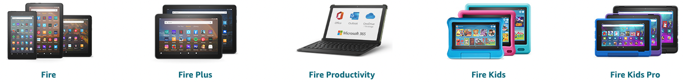

Companies create new products to grow,
A Product line is a group of related products marketed under the same brand name that is made by the same company.
Amazon Fire (tablets)
Google Workspace

Slide 18
As they add more products, they create a portfolio of products, organized by groups, family, lines
Product Portfolio
Product Family 1
Product Family 2
Product Line A
Product Line B
Product Line C
Product Line D
Product A1
Product C1
Model 1
Module 1
Model 2
Module 2
Model 3
Module 3
Product A2
Product C2
Product A3

Slide 19
Discussion: How is Microsoft’s portfolio structured?
Product Portfolio
Product Family 1
Product Family 2
Product Line A
Product Line B
Product Line C
Product Line D
Product A1
Product C1
Model 1
Module 1
Model 2
Module 2
Model 3
Module 3
Product A2
Product C2
Product A3

Slide 20
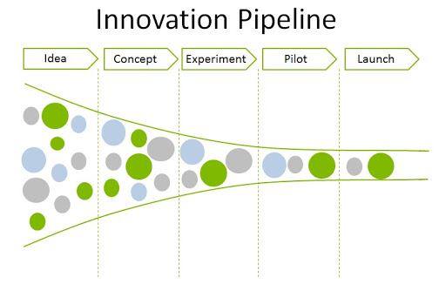
Companies seek to continuously introduce new products to market, to grow and stay competitive
https://markdjacobsen.com/2020/08/28/7-models-of-bureaucratic-innovation/

Slide 21
But new product innovation is risky…
35 - 49% of new products are failures*
failure = the product did not meet the company’s expectations / objectives
* Study in 2013 by the Product Development and Management Association.

Slide 22
Companies have to “evaluate” the product ideas before moving forward
Why should we make this product?
The answer is of the form: Benefits – Costs >> 0
The benefits to us must be much greater than the costs to us.
The benefits and costs can be quantitative (preferred) and qualitative)
They’ll re-evaluate, too, as the idea is further developed.

Slide 23
You need to persuade people to invest in your idea. You need to make a “business case”. This is what you’ll learn to do in this course.

Slide 24
About the Course

Slide 25
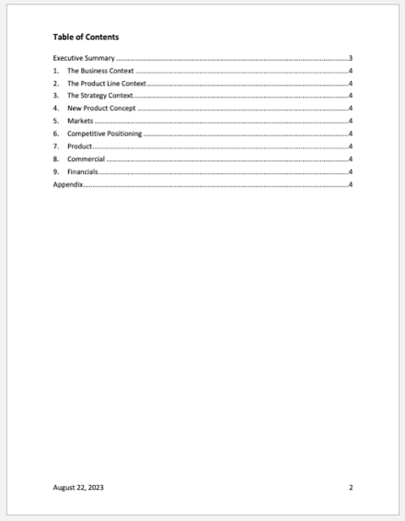
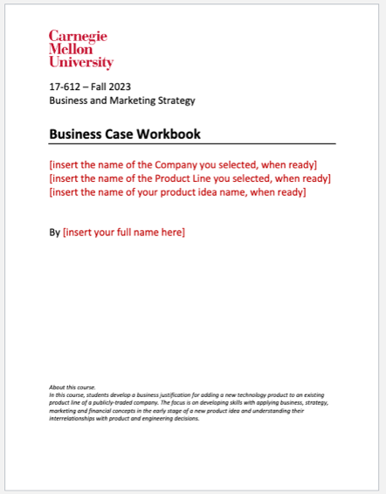
Each student will work individually on a course-long project.
choose a publicly-traded company
choose one of its product lines
conceive a new product idea for that line
make some “design” decisions and strategy decisions
make a business case to justify developing the idea
With a projection of revenue, expenses and profits
Act as if you’re working at the selected company!

Slide 26
Product Assignments
6 Product Assignments – over 7 weeks.
85% of your grade
Each Product Assignment builds upon your work in the previous assignment
We grade your submission, but you can revise your work afterwards.
Using our feedback, your own learning, and new ideas that you have
Not re-graded…but if you make decisions based on changes, we need to follow the changes.

Slide 27
Peer Learning Activity
Learn from your peers
Everyone will be put into a peer group of 4 students
Activity No. 1
Share your company and product lines with your peers; get their new product ideas before you decide and submit your idea
Activity No. 2
Share your new product idea; get their suggestions on product “design” before you decide onand submit your design.
Activities can be done asynchronously, or you can choose to have a meeting.

Slide 28
Grading and Assignment Schedule
Product Assignment | Due Date | 100 Points
Product Assignment 1 | Tue Sep 5 | 100
Peer Learning Activity 1 | Thu Sep 7 / Sat Sep 9 | 75
Product Assignment 2 | Tue Sep 12 | 100
Product Assignment 3 | Tue Sep 19 | 150
Peer Learning Activity 2 | Thu Sep 23 / Sat Sep 25 | 75
Product Assignment 4 | Tue Sep 26 | 150
Product Assignment 5 | Tue Oct 3 | 150
Product Assignment 6 | Sat Oct 14 | 200
 |  | 100 points

Slide 29
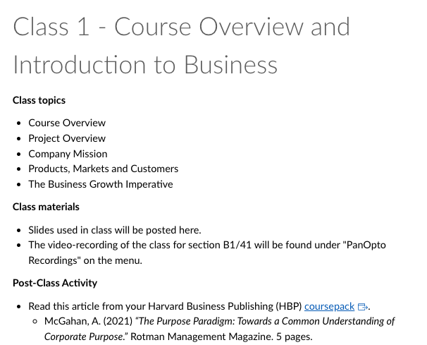
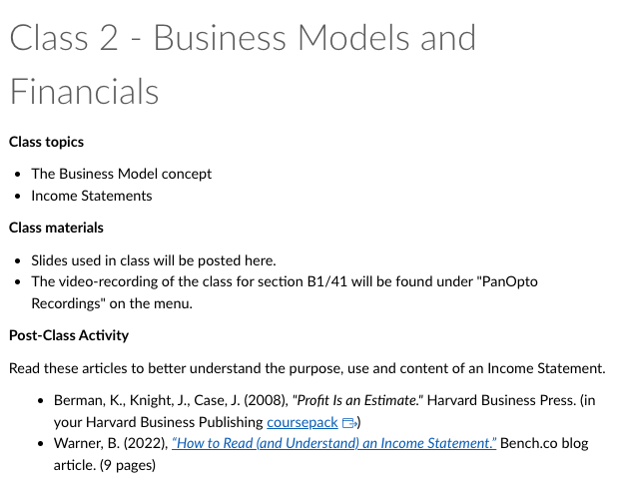
After each class, there are readings, videos, examples
Plus, the class slides and recording of class section B1

Slide 30
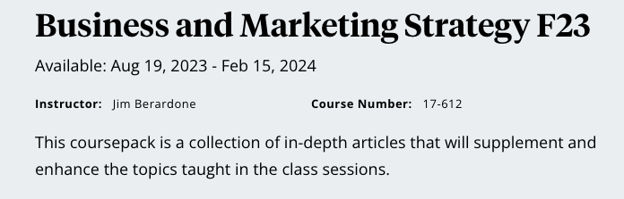
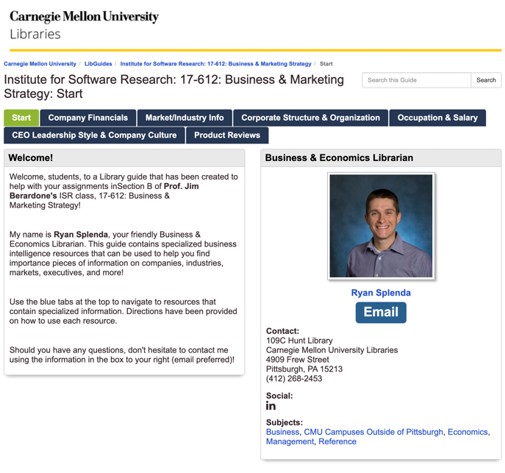
Key Resources
Recitation sessions
Monday 7 pm ET to 8 pm ET by Zoom
Anyone can participate
Let me know by the night before (about 10 pm Eastern Time)

Slide 31
Your work cadence could look like this:
Tue | Wed | Thu | Fri | Sat | Sun | Mon
Class | Post-Class Activity | Class | Post-Class Activity | Product Assignment work
Tue | Wed | Thu | Fri | Sat | Sun | Mon
Product Assignment is due Class

Slide 32
Policy on use of ChatGPT and other GenAI
Use them!
You are responsible for what you submit.
Recognize if it’s correct, accurate.
Recognize if it is consistent with what I am teaching and how I teach it.
Be very careful with numbers.
Sometimes, you will be asked to cite your sources. ChatGPT is not the source.
Think like this:
You’re working for the company.
Your manager or their manager asks - where did you get that from?

Slide 33
Product Assignment No. 1 – The Business and Product Line Context
Due Tue Sep 5 at start of class
1. Select a publicly-traded company
2. Select a product line in the company
LATER, you’ll conceive an idea to add to it.
3. Find, capture info to describe the company
4. Find, capture info to describe the product line
Business Case Workbook.docx

Slide 34
Selecting and describing a Company

Slide 35
Selecting a company
Think like “I am working there and proposing a new product idea”
The company can be located anywhere
It can be in any industry, any type, but it’s strongly preferred to be where creating a new “technology product” would be a good fit.
Tech could be software, hardware, electronics, machines, devices, materials, instruments, media, etc.
It must be a publicly-traded, for-profit company.
It’s traded on a stock exchange.
They must have at least 3 full years of reported financial information.

Slide 36
How do you know if a company is publicly-traded?

Slide 37
Publicly traded companies…
Publicly-traded company (“Publicly-held,” ”public company”) | Private company (“Privately-held,” “closely-held”)
An organization that has sold all or parts of its ownership (stock) to the general public using a stock exchange (e.g., NYSE, NASDAQ) | The company is not owned by the public. It’s an “unlisted” company.
Required to file quarterly financial reports which is made available to investors and the public. | Do not need to file or publish their financial reports.
The management team answers to stockholders. | The management team does not need to answer to stockholders.

Slide 38
For-Profit and Not-For-Profit organizations can earn profits.
For-Profit business | Not-For-Profit organization (a.k.a. Nonprofit. 501(c)(3) corporation)
“An organization for the purpose of making a profit.” -- Cambridge English Dictionary | “Group organized for purposes other than generating profit and in which no part of the organization’s profit is distributed to its members, directors, or officers.” -- Cornell Law School (LII)
They have owners of stock in the organization. | There are no owners of stock in the organization. “Non-stock corporations”
Profits can be distributed to its owners. | Profits can’t be distributed –> no owners

Slide 39
Describing a company with these 10 items
Company Name
Stock Exchange Symbol
Website
Corporate Headquarters Location
Total annual revenue
Number of employees
Company Age
Business Summary
Mission Statement
Financials
You’ll need to find these for your Product Assignment No. 1.
They’ll provide context for later decisions.

Slide 40
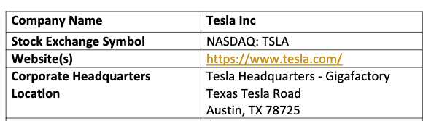
Explanations – items 1 to 4
Company Name
Include any acronym or abbreviation
(Example: International Business Machines (IBM)
2. Stock Exchange and Symbol
The stock exchange that it is traded on and its identifier (a.k.a. symbol). (Example: NYSE, AMZN)
3. Website
Provide a link to the home page. We may need to look at it.
4. Corporate Headquarters Location
Where is its main office?
Some companies are fully remote, but in the USA, they must be “incorporated” in a state. Use that location.

Slide 41
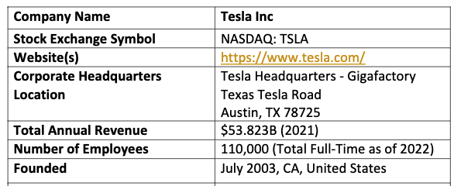
Explanations – items 5 to 7
5. The total annual revenue
Capture the total revenue for the most recent full year.
This helps to understand the company’s “size”
Note: companies report using “fiscal years.” Use that.
That isn’t always the same as the calendar year.
6. Number of of employees
This number is likely estimated.
This helps to understand the company’s ”size” in a different way.
7. Company Age
When was fit founded? How many years in business?

Slide 42
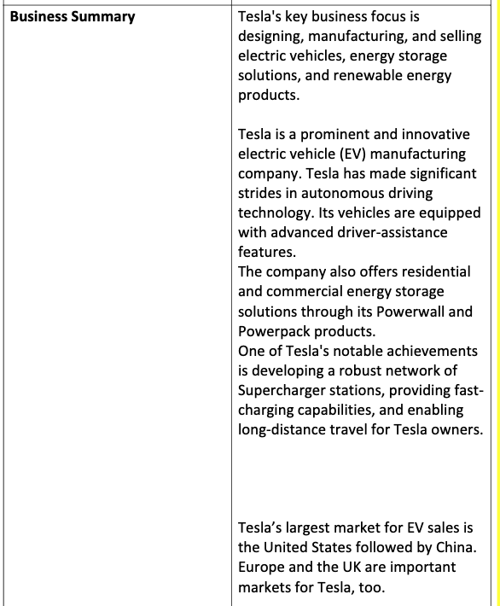
Explanation – item 8
8. Business Summary
In 1 to 3 paragraphs, identify:
- what the company does
- the key products or services or programs they offer
- the markets that it serves.

Slide 43
Explanation – item 9
9. Mission Statement
Why does the company exist?
What is it trying to accomplish?
What is it striving for?
You can use the mission published by the company, exactly, without elaboration and without any academic integrity issue.
In some cases, a company may not publish a statement. You will have to infer it from their business and state that you did this.
Mission Statement | Tesla’s mission is to accelerate the world’s transition to sustainable energy.

Slide 44
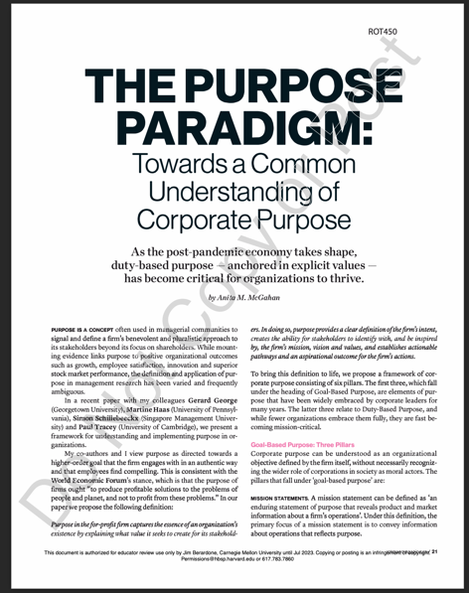
More about Mission, Vision, Values, and more.
In your Coursepack from HBP.
When conceiving new product ideas, it helps the company’s
Vision
Values
Strategic intent (next class)
Sometimes, these aren’t clear…

Slide 45
Explanation – item 5 → Financials of last 3 full years
Revenue per year
Revenue change (%) from the prior year
Gross Profit
Gross Profit change (%) from the prior year
Gross Profit Margin (%)
Gross Profit Margin (%) change (%) from the prior year
Net Income
Net Income change (%) from the prior year
Net Profit Margin (%)
Net Profit Margin (%) change (%) from the prior year
Sales and Marketing (S&M) expense
Research and Development (R&D) expense
General and Administrative (G&A) expense
We’ll discuss each item in the next class.

Slide 46
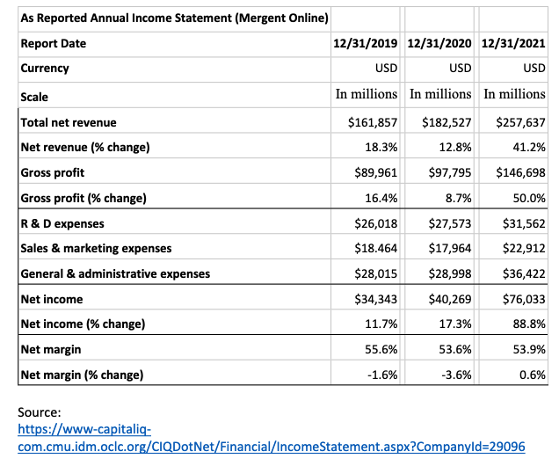
Financials example – Google – 2019, 2020, 2021

Slide 47
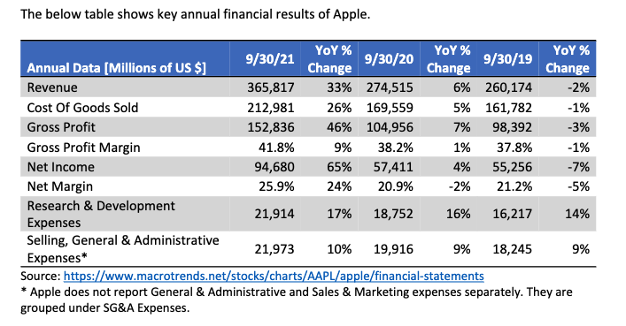
Financials example – Apple 2019, 2020, 2021

Slide 48
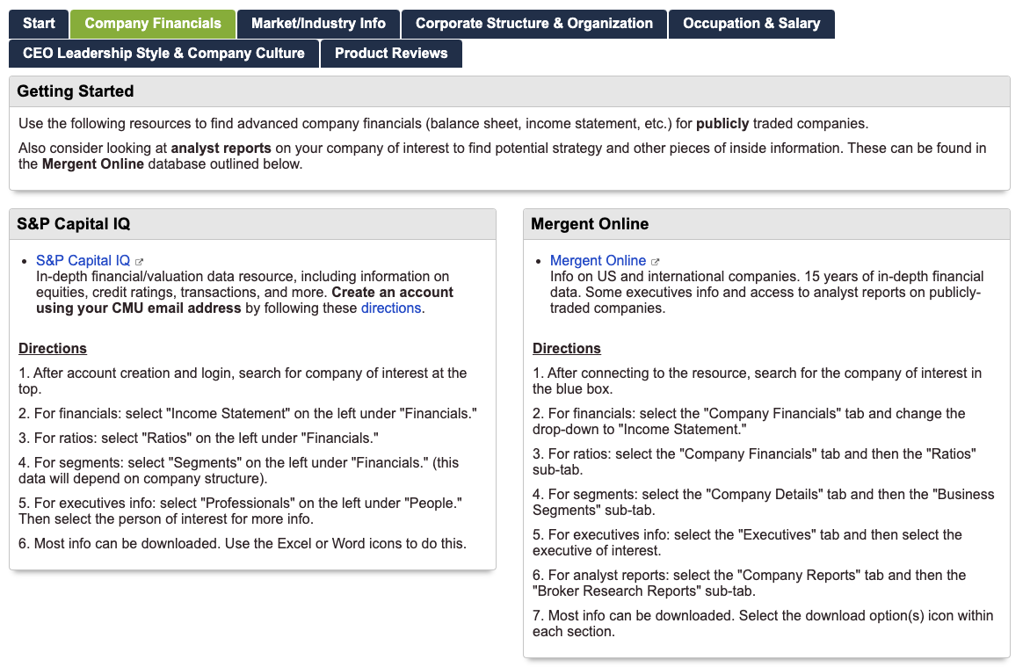
Go to Course Library, Company Financials tab
Don’t search for a
company’s Annual Reports
one per year
too cumbersome to go through
Use S&P Capital IQ or Mergent Online
- Reliable, extracted, organized
Search by Company Name

Slide 49
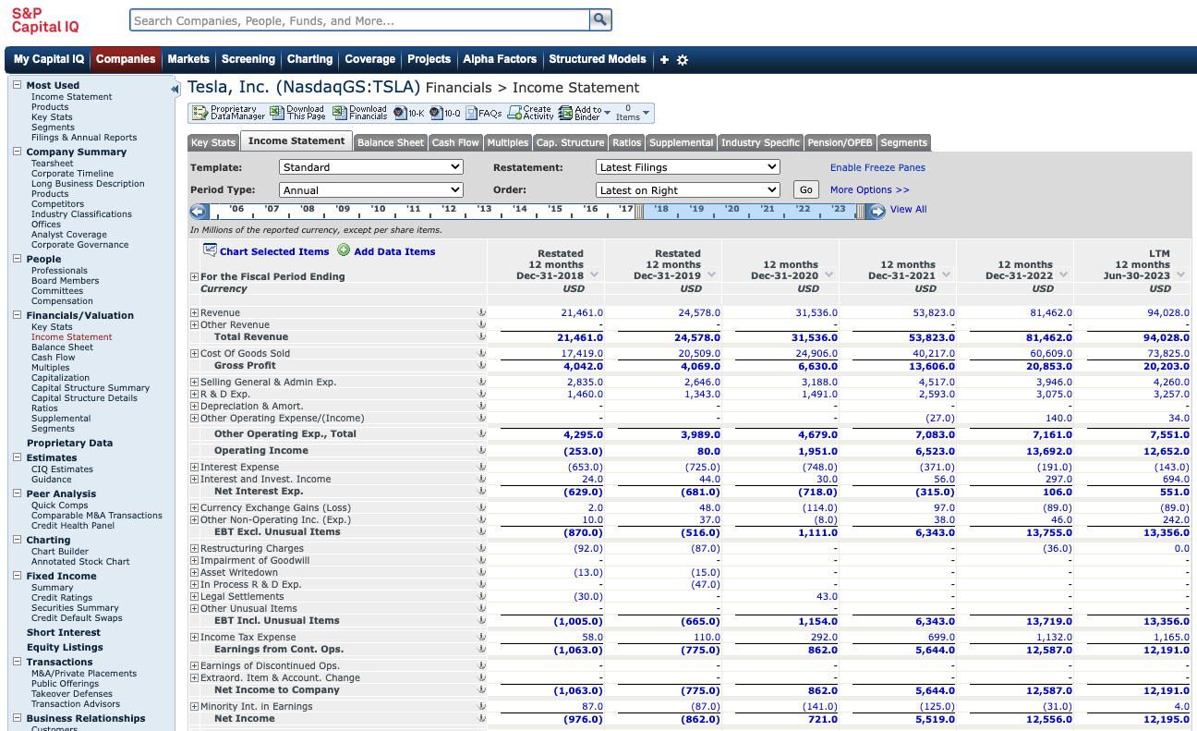
You’ll get the financials data, like this for Tesla.
Use Income statement

Slide 50
Selecting and describing a Product Line

Slide 51
Selecting a Product Line
You do not need a new Product Idea yet.
Select a product line which would make sense to add a technology-based idea to it
Tech could be software, hardware, electronics, machines, devices, materials, instruments, digital media, etc.
If you do have a new product idea already, then you need to identify the product line that would be the best fit for it.
Pretend, you work there.
You’d propose your idea to the head/manager of an existing product line to get support, funding for it.

Slide 52
How would you describe a product line? What information would you communicate?

Slide 53
Describing a product line
1. Brand Name
2. Website URL
3. Product Line Overview
4. Describe each product in the line
a. Brand name
b. Type of product
c. Key features and characteristics
d. Platform/technologies
For your Product Assignment, don’t describe more than 5 products in a line. Select the most significant ones.

Slide 54
Explanations
Brand Name - names given by the maker to a group of products and individual products
Website URL – for your future reference and ours.
Product Line Overview - A summary and history.
What types of products are in this line? Which markets are served by it? When was it first introduced, approximately? Any significant changes since then?
Type of Product – a label that describes a category or class of products.
Key features and characteristics – primary and unique attributes of a product
Platform/technologies – the “technology” that is used to host an app, service, other products

Slide 55
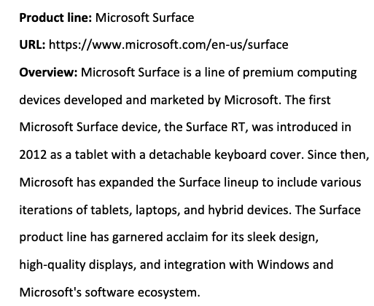
Product line example – Microsoft Surface (abt. 2022)

Slide 56
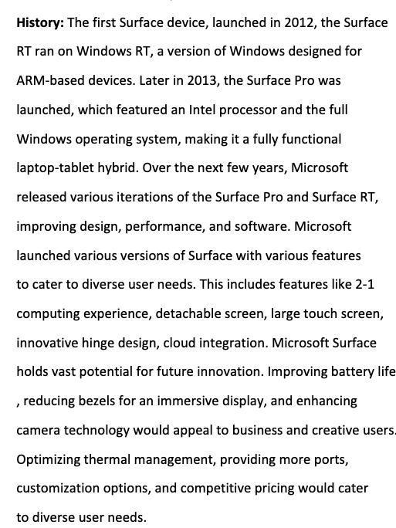
Example continued
Captures how the product line has evolved over time.
The trends shows that MS innovates regularly, and your idea should support that.

Slide 57
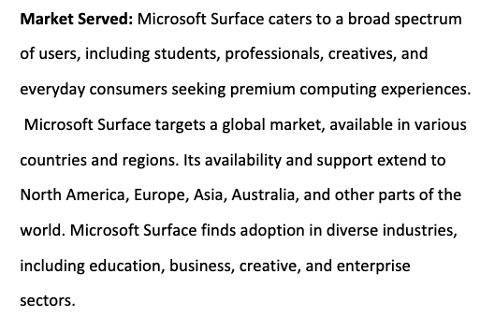
Example continued
Captures:
The users
Geographies
Industries

Slide 58
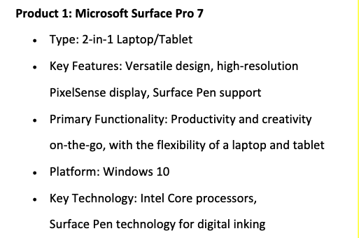
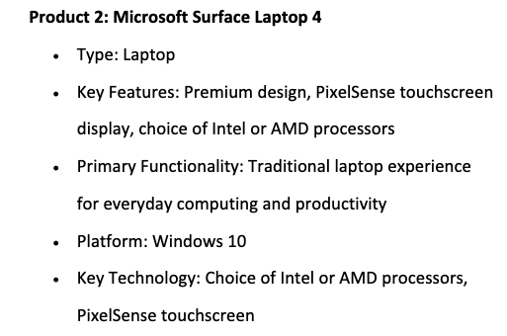
Example continued – 2 products in the product line

Slide 59
Next Class: Business Models and Financials

